Slide 1
CSET301 – AI-ML
Lecture 12 : Boosting Methods

Slide 2
Outline
Boosting methods
Adaboost
Gradient Boosting

Slide 3
Boosting
For classification, we use AdaBoost
For regression and classification, we can use Gradient Boosting

Slide 4
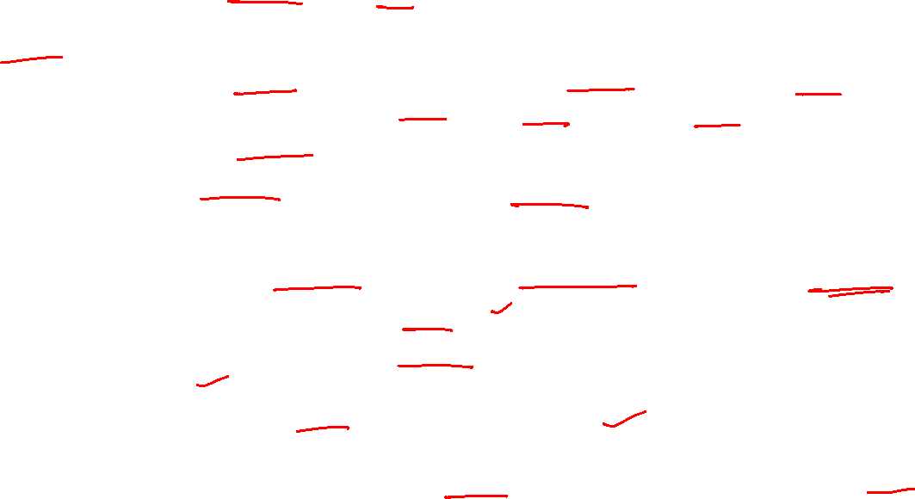
AdaBoost: Adaptive Boosting
Analogy:
Imagine you’re taking a test and keep making mistakes on certain types of questions.
Next time, your teacher gives you more practice on the mistakes you made, instead of repeating what you already know.
Over time, you get better because you’re focusing on your weak areas.
That’s exactly what AdaBoost does with models:
It starts with a simple weak model (like a small decision tree, called a “stump”).
It checks where the model made mistakes.
Next model focuses more weight on those mistakes (so it tries harder on hard-to-classify points).
Finally, all models are combined (like a weighted vote).
The model adjusts the weights of weak learners and try to make the model better.

Slide 5
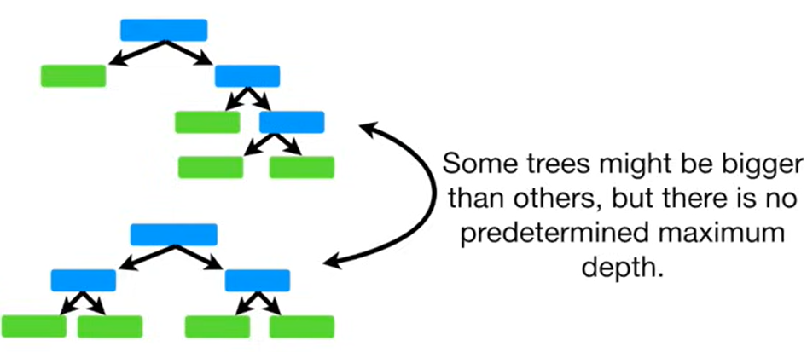
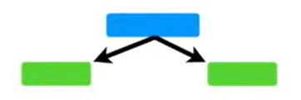
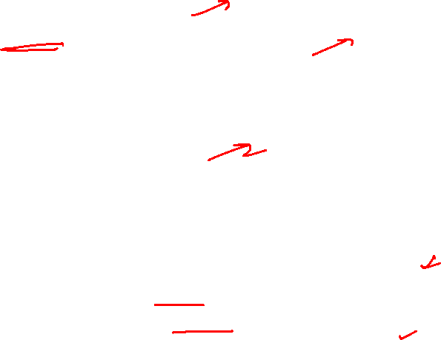
Decision Tree vs AdaBoost
Decision Trees
Stump
(weak learners)

Slide 6
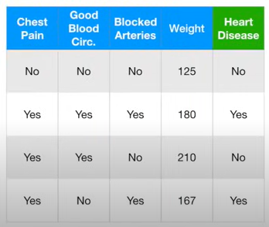
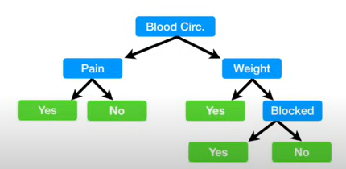
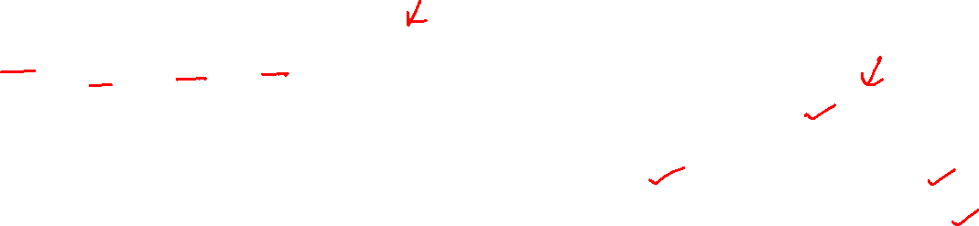
Decision Tree vs AdaBoost
Lets say this is the given data set and we want to predict if someone has heart disease, then a full-size decision tree would look something like this, that is, uses all features given in data.

Slide 7
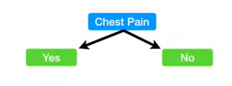
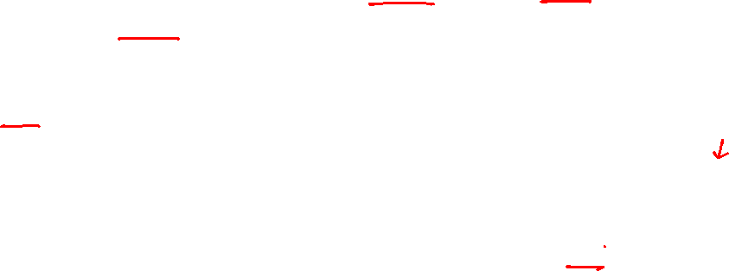
Decision Tree vs AdaBoost
But a stump can use only one variable to make a decision. That’s why they are called “weak learners”.

Slide 8
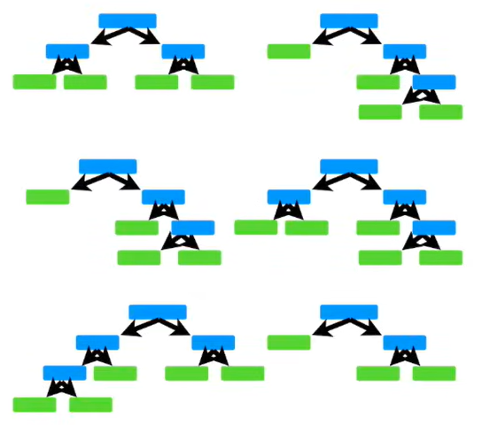
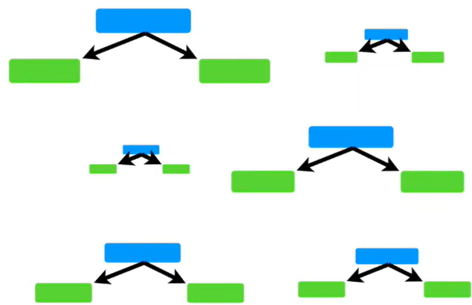
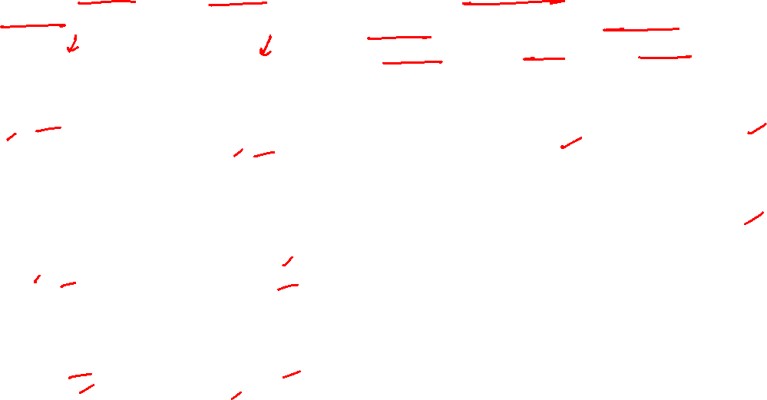
Random Forest vs AdaBoost
In Random Forest, each tree has an equal vote on the final classification.
Whereas in Forest of Stumps made with AdaBoost, some stumps get more vote weightage in final classification than others

Slide 9
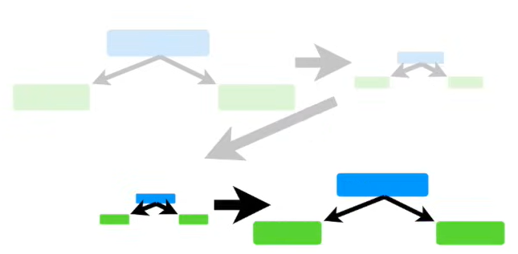
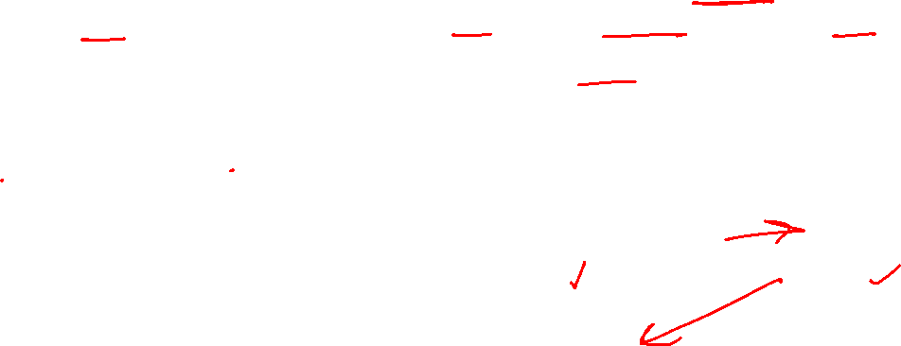
Random Forest vs AdaBoost
In Random Forest, each decision tree is made independently of the others
Whereas in AdaBoost, order is important. The errors that the first stump make influence how the second stump is made, and so on.
Notes:
In random forest, it doesnot matter if first tree is made first or the second one or the last one.

Slide 10
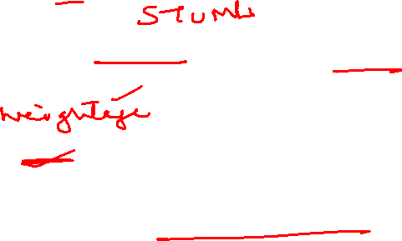
AdaBoost: Adaptive Boosting
3 Key Ideas behind AdaBoost:
AdaBoost combines a lot of “Weak learners” to make classifications. The weak learners are almost always stumps.
Some stumps get more say in classification than others.
Each stump is made by taking the previous stump’s mistakes into account.

Slide 11
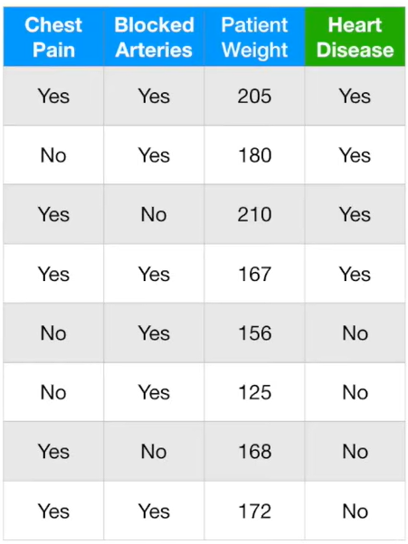
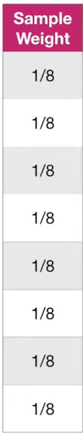
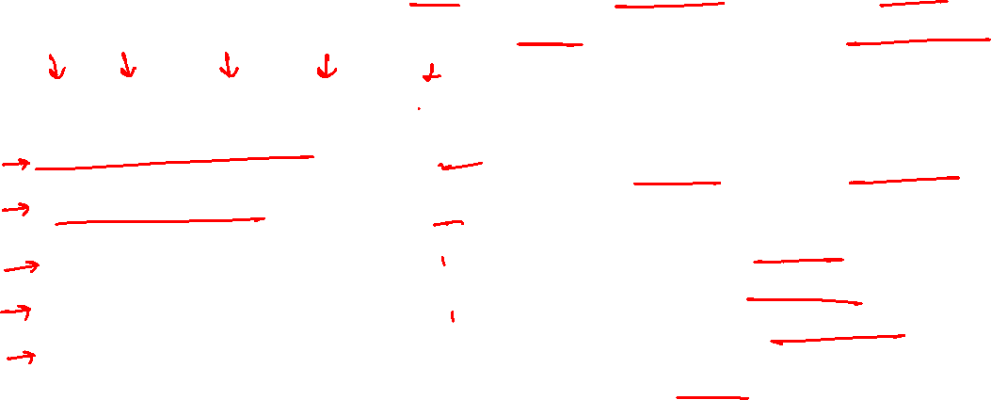
AdaBoost: Example
Lets say we want to predict if a patient has heart disease using AdaBoost.
First, we give each training sample a weight. Initially, it is equal for all samples.
Sample weight = 1 / Total num of samples
After the first stump is made, these sample weights will change in order to guide how the next stump is created.

Slide 12
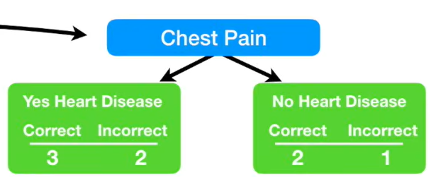
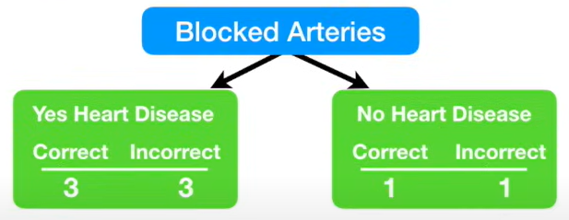
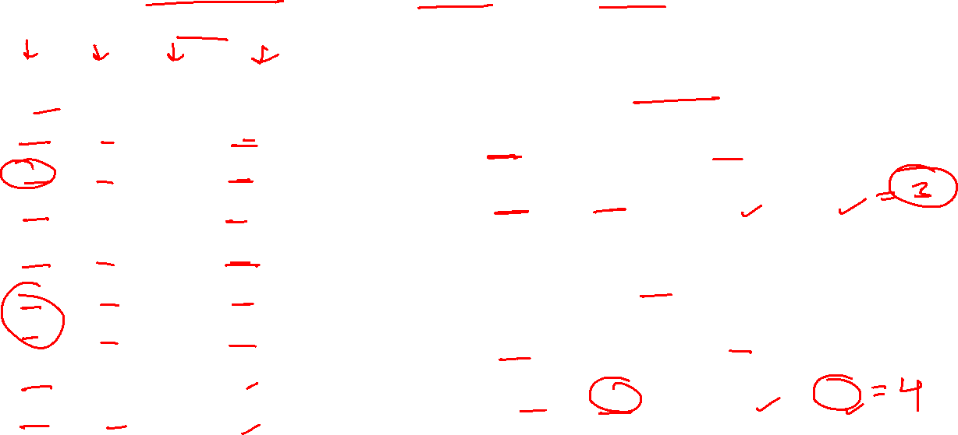

AdaBoost: Example
The first stump in the forest is made by finding the variable/feature that does the best classification
Notes:
In chest pain, out of 5 samples with chest pain, 3 were correctly classified with heart disease. And Out of 3 samples with no chest pain, 2 are correctly classified with no heart disease.
In Blocked arteries, out of 6 samples with yes, 3 were correctly classified as heart disease. And out of 2 samples with no blocked arteries, 1 is correctly classified as no heart disease.

Slide 13
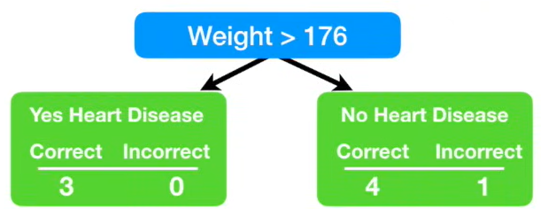
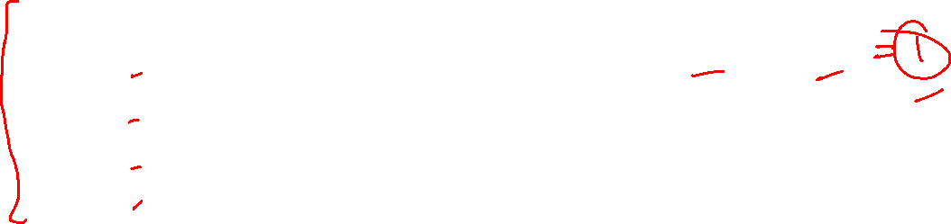
AdaBoost: Example
The first stump in the forest is made by finding the variable/feature that does the best classification
Notes:
Similarly, we looked at weight feature.

Slide 14
AdaBoost: Example
Then we calculate the gini index for each stump. Gini index for Weight is the least. So, weight will be the first stump in the forest.
0.47
0.5
0.2

Slide 15
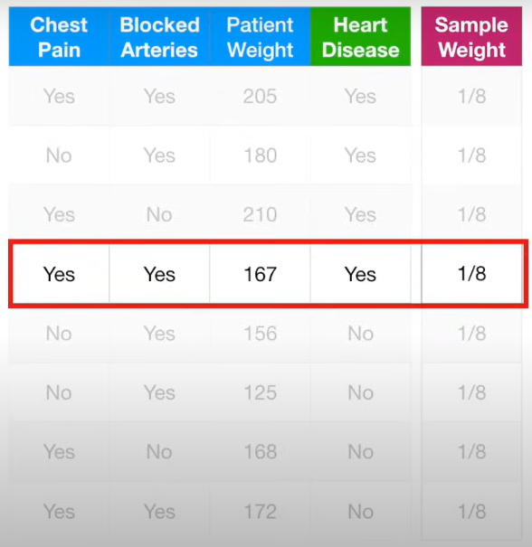
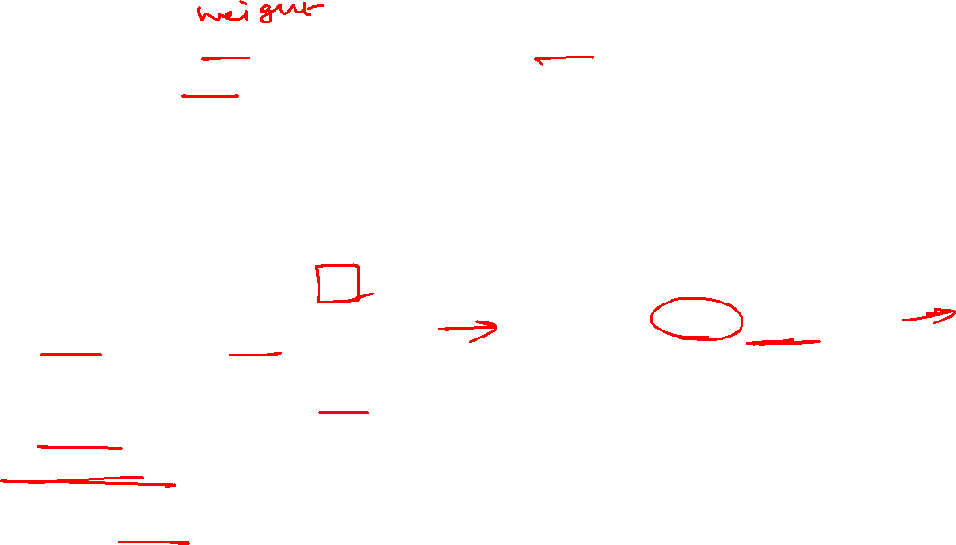
AdaBoost: Example
Now lets see how much say this stump has in final classification. It depends on how well it classifies the data.
Here, this stump makes just 1 error.
The total error for a stump is the sum of the sample weights associated with the incorrectly classified samples.
Here, total error = 1/8

Slide 16
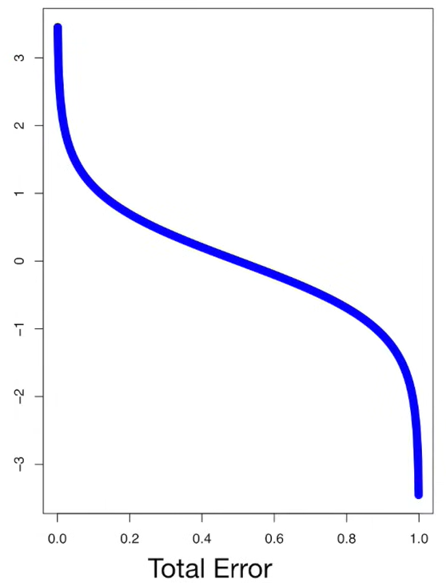
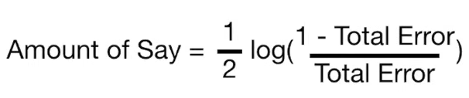

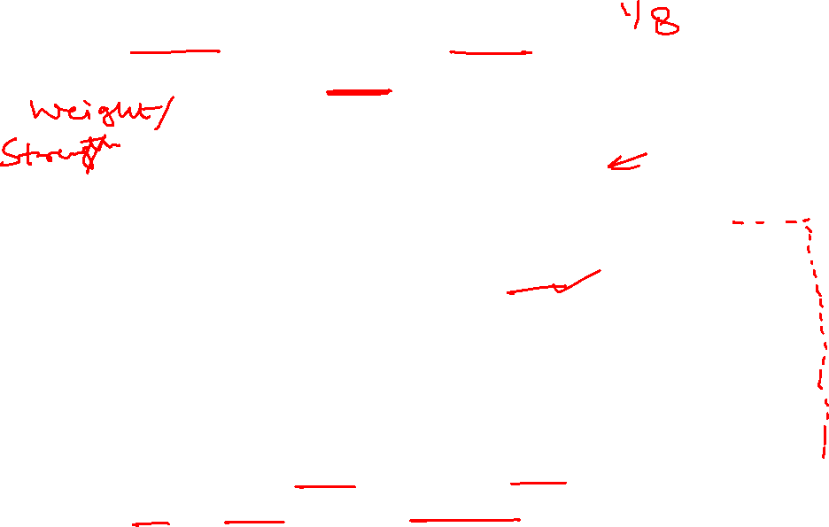
AdaBoost: Example
Amount of Say depends on Total error.
Amount of Say for Weight is:
The blue line in the curve tells us the amount of say for total error values between 0 and 1
Notes:
When stump does the absolute correct classification – total error is 0 , therefore amount of say is relatively large, positive number.
When a stump is no better than flipping a coin and total error is 0.5, amount of say is 0.
When error is large, amount of say is negative value.

Slide 17
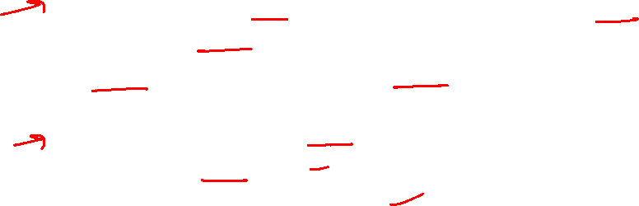
AdaBoost: Example
Just for Exercise:
Similarly, just for idea, we can find amount of say for Chest Pain and Blocked Arteries stump (Not required though since they are not the best stumps)
Total Error = Sum of sample weights for the incorrectly classified samples
Chest Pain made 3 errors, and the sample weight is 1/8 for all samples. Therefore, Total error = 3/8
Amount of say = ½ log (7/3) = 0.42
Blocked arteries made 4 errors, therefore
Total Error = 4/8 = ½
Amount of say = ½ log (1) = 0

Slide 18
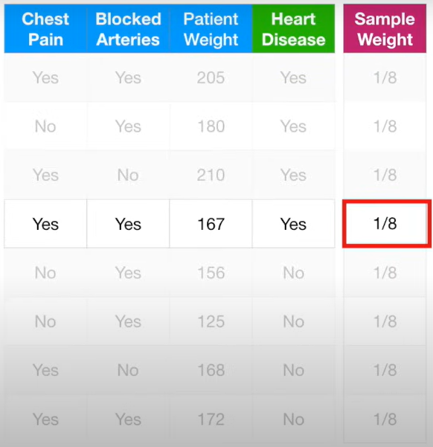

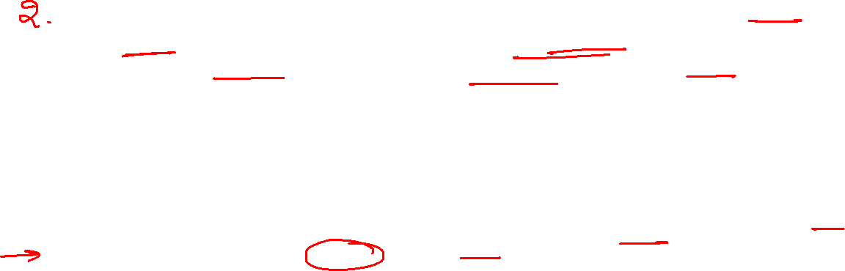
AdaBoost: Example
Modifying sample weights: Since Weight stump incorrectly classified one data point/sample. We want the next stump to correctly classify it. This is done by increasing its sample weight and decreasing sample weight of all other samples.

Slide 19
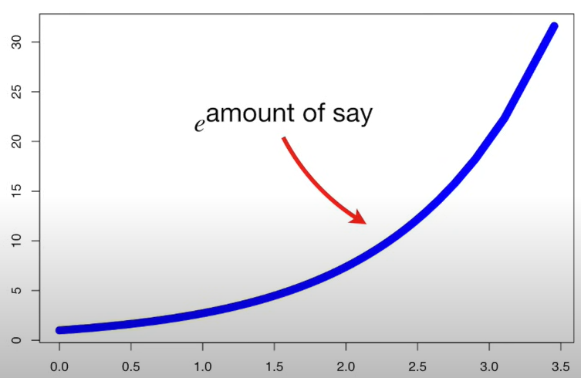
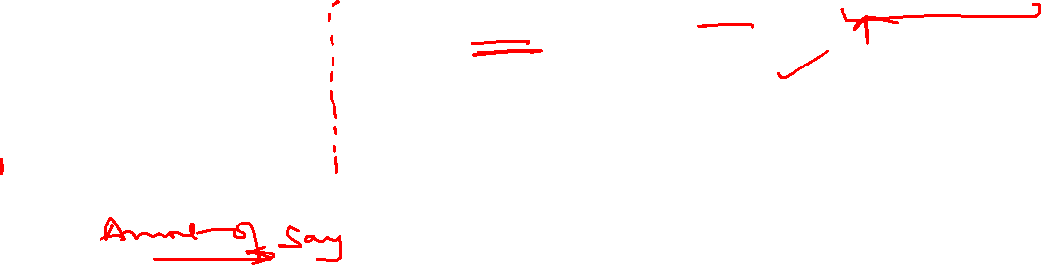
AdaBoost: Example
The term e^{amount of say} scales the values of sample weight. The more the amount of say, the more the scaling

Slide 20
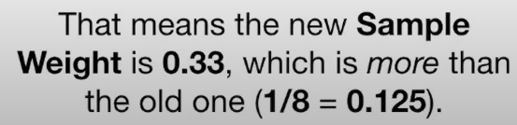
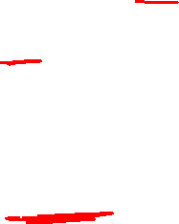

AdaBoost: Example
Modifying sample weights: Since Weight stump incorrectly classified one data point/sample. We want the next stump to correctly classify it. This is done by increasing its sample weight and decreasing sample weight of all other samples.

Slide 21
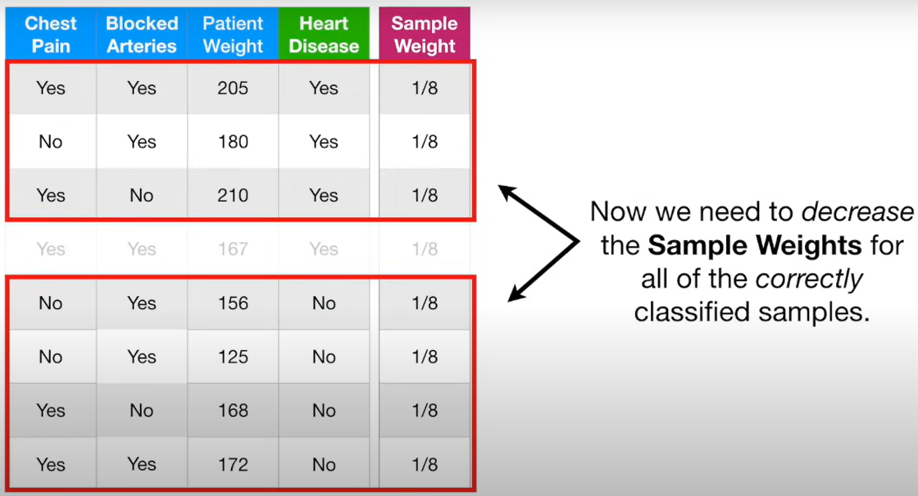

AdaBoost: Example

Slide 22
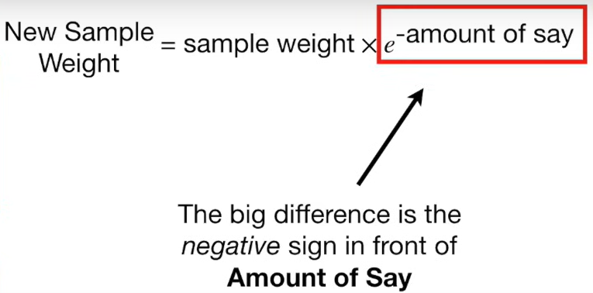
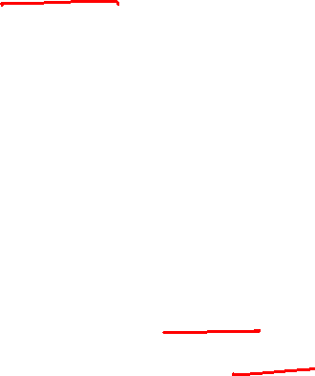
AdaBoost: Example
Formula for decreasing the sample weights:

Slide 23
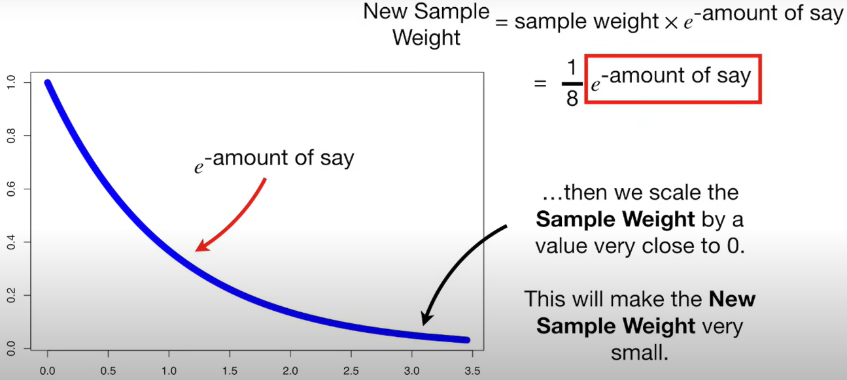
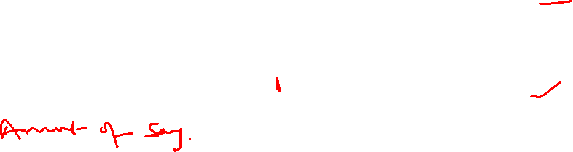
AdaBoost: Example

Slide 24
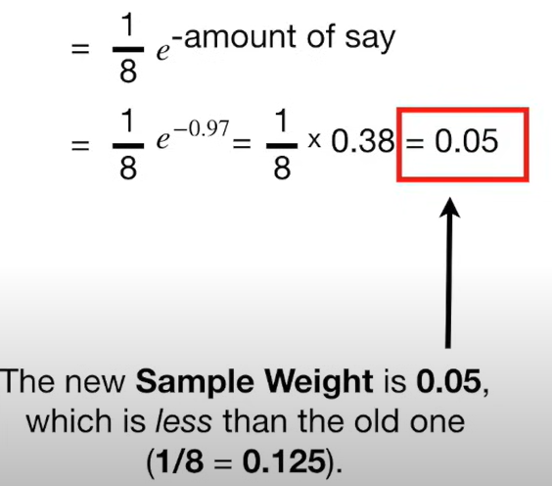
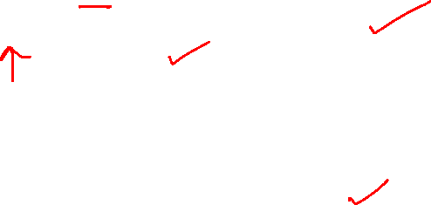
AdaBoost: Example

Slide 25
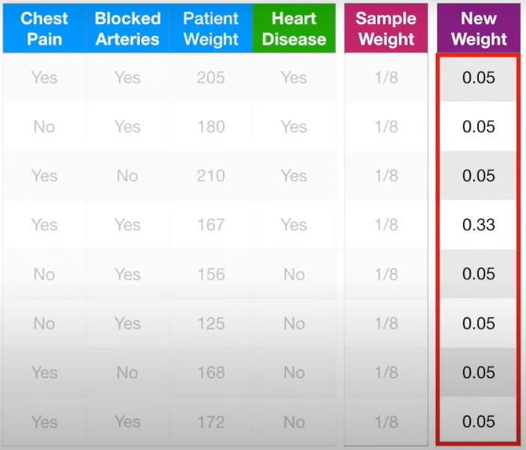
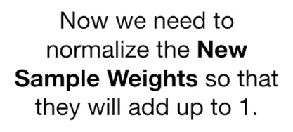
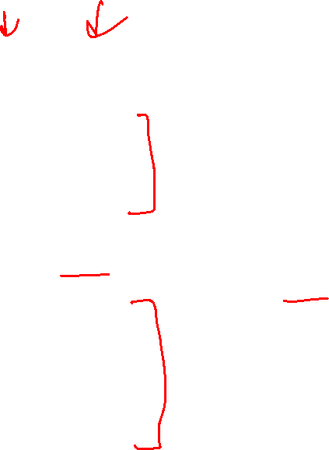
AdaBoost: Example

Slide 26
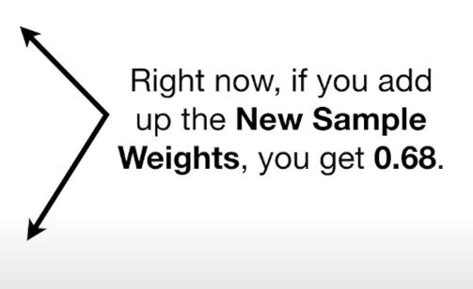
AdaBoost: Example

Slide 27
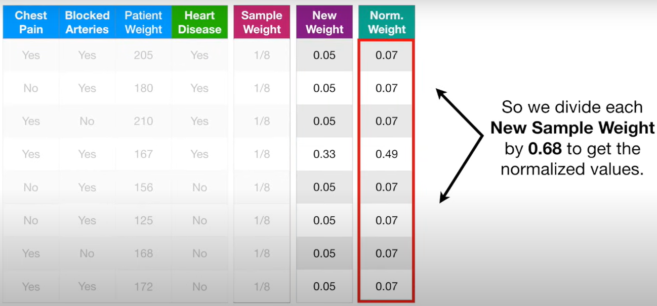
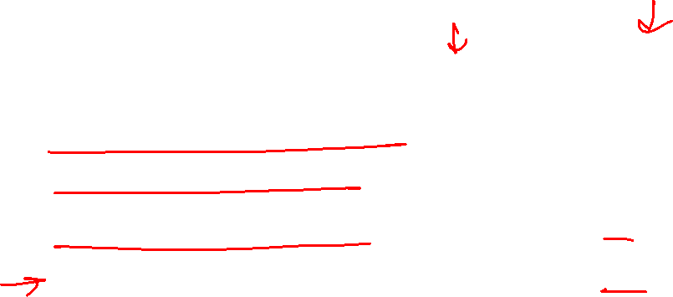
AdaBoost: Example

Slide 28
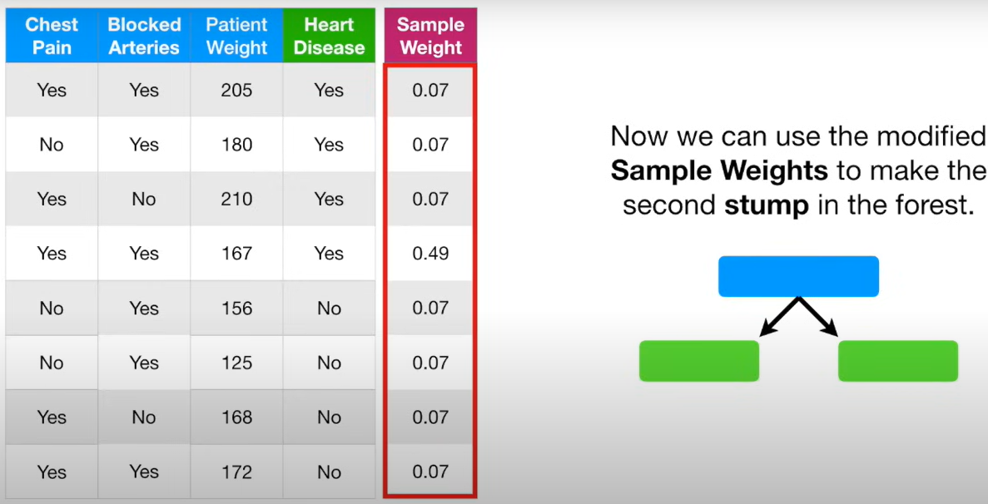
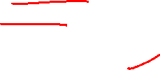
AdaBoost: Example

Slide 29





AdaBoost: Example
3. Combining the stumps

Slide 30


AdaBoost: Example
4. Final Classification

Slide 31


AdaBoost
The num of stumps in AdaBoost is not fixed – it is a hyperparameter.

Slide 32
Thank You

